Slide 1
R programming
AlcoholConsumption_AUS_AUT
Name:-PATEL VANSHKUMAR JAYANTIBHAI 20220701018

Slide 2
INTRODUCTION OF THE PROJECT
Alcohol consumption is a multifaceted aspect of societal behavior, influenced by cultural, economic, and policy factors.
This project delves into a comprehensive analysis of global alcohol consumption trends, focusing on data from specific countries such as Australia and Austria.
The dataset, named "GlobalAlcoholTrends," captures information spanning several decades, allowing for an in-depth exploration of how consumption patterns have evolved over time.

Slide 3
DATASET DESCRIPTION
The dataset captures alcohol consumption trends across locations, providing information on the type of data measured ("ALCOHOL"), subject category ("TOT" for total consumption), and Litres/Capita for each year.
With details on geographic locations such as Australia and Austria, the dataset facilitates concise analysis of cross-country patterns and temporal trends in alcohol consumption.
The metric "Litres/Capita" quantifies per capita alcohol consumption in liters, offering valuable insights for research on public health and policy strategies.

Slide 4
Columns in the Dataset
Index
LOCATION
INDICATOR
SUBJECT
TIME
LITRES/CAPITA

Slide 5
STATISTICAL ANALYSIS

Slide 6
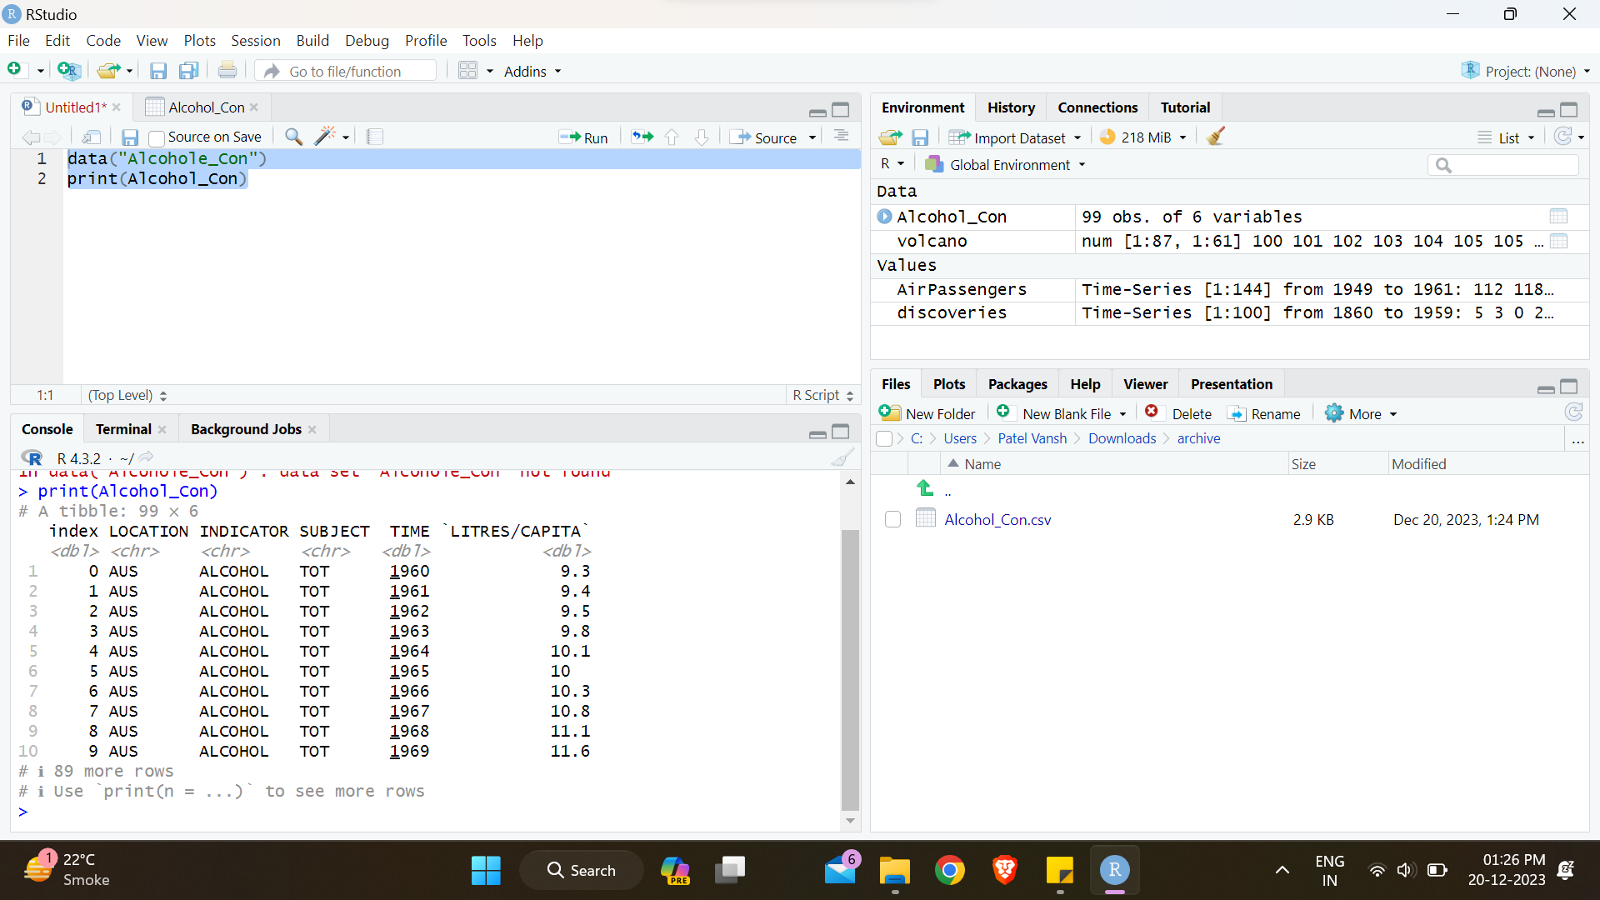
Print the data set
Printing the dataset
Code:-max(Alcohol_Con$`LITRES/CAPITA`)

Slide 7
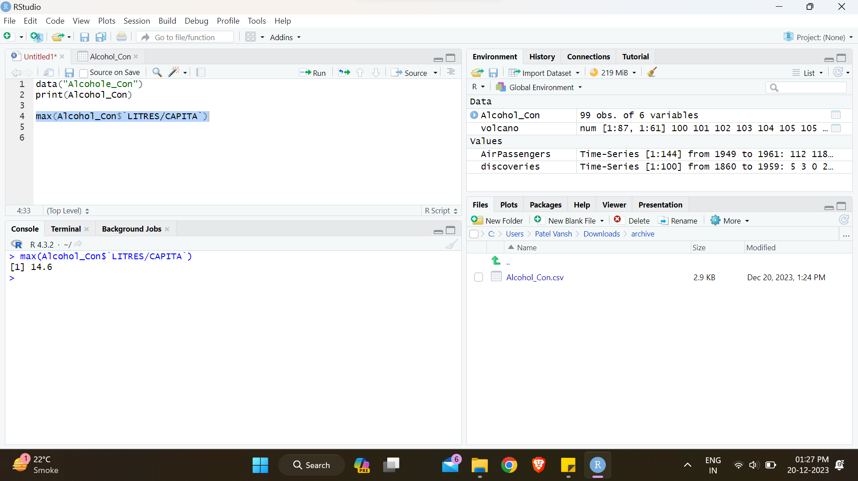
MAXIMUM
Finding maximum for litres/capita
Code:-max(Alcohol_Con$`LITRES/CAPITA`)

Slide 8
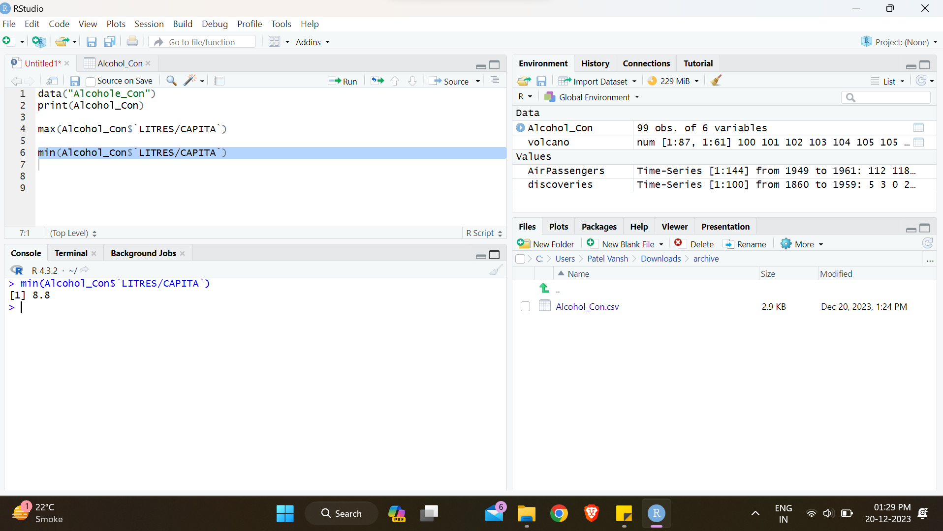
MINIMUM
Finding minimum for litres/capita
Code:-min(Alcohol_Con$`LITRES/CAPITA`)

Slide 9
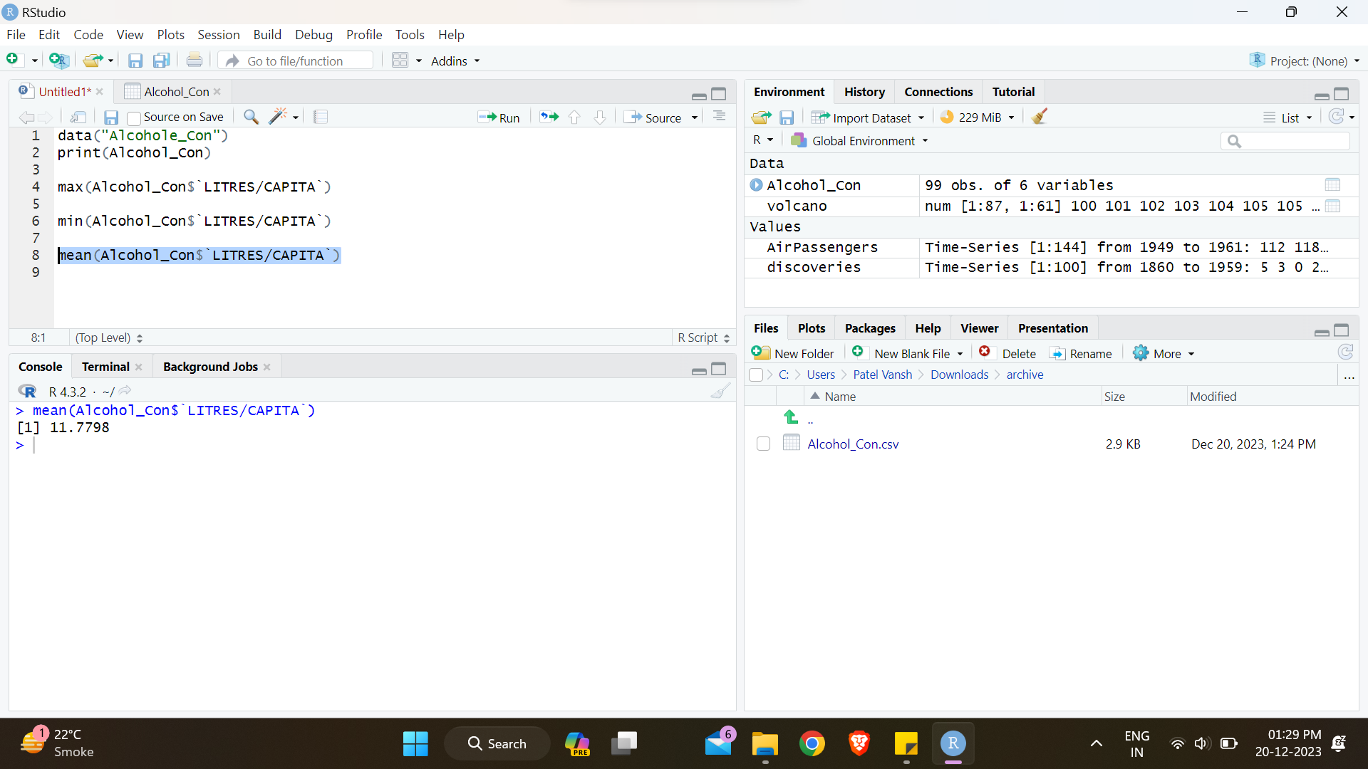
MEAN
Mean refers to finding average of whole dataset by adding all numbers and then dividing them with total number of dataset.
Finding mean for litres/capita
Code:-mean(Alcohol_Con$`LITRES/CAPITA`)

Slide 10
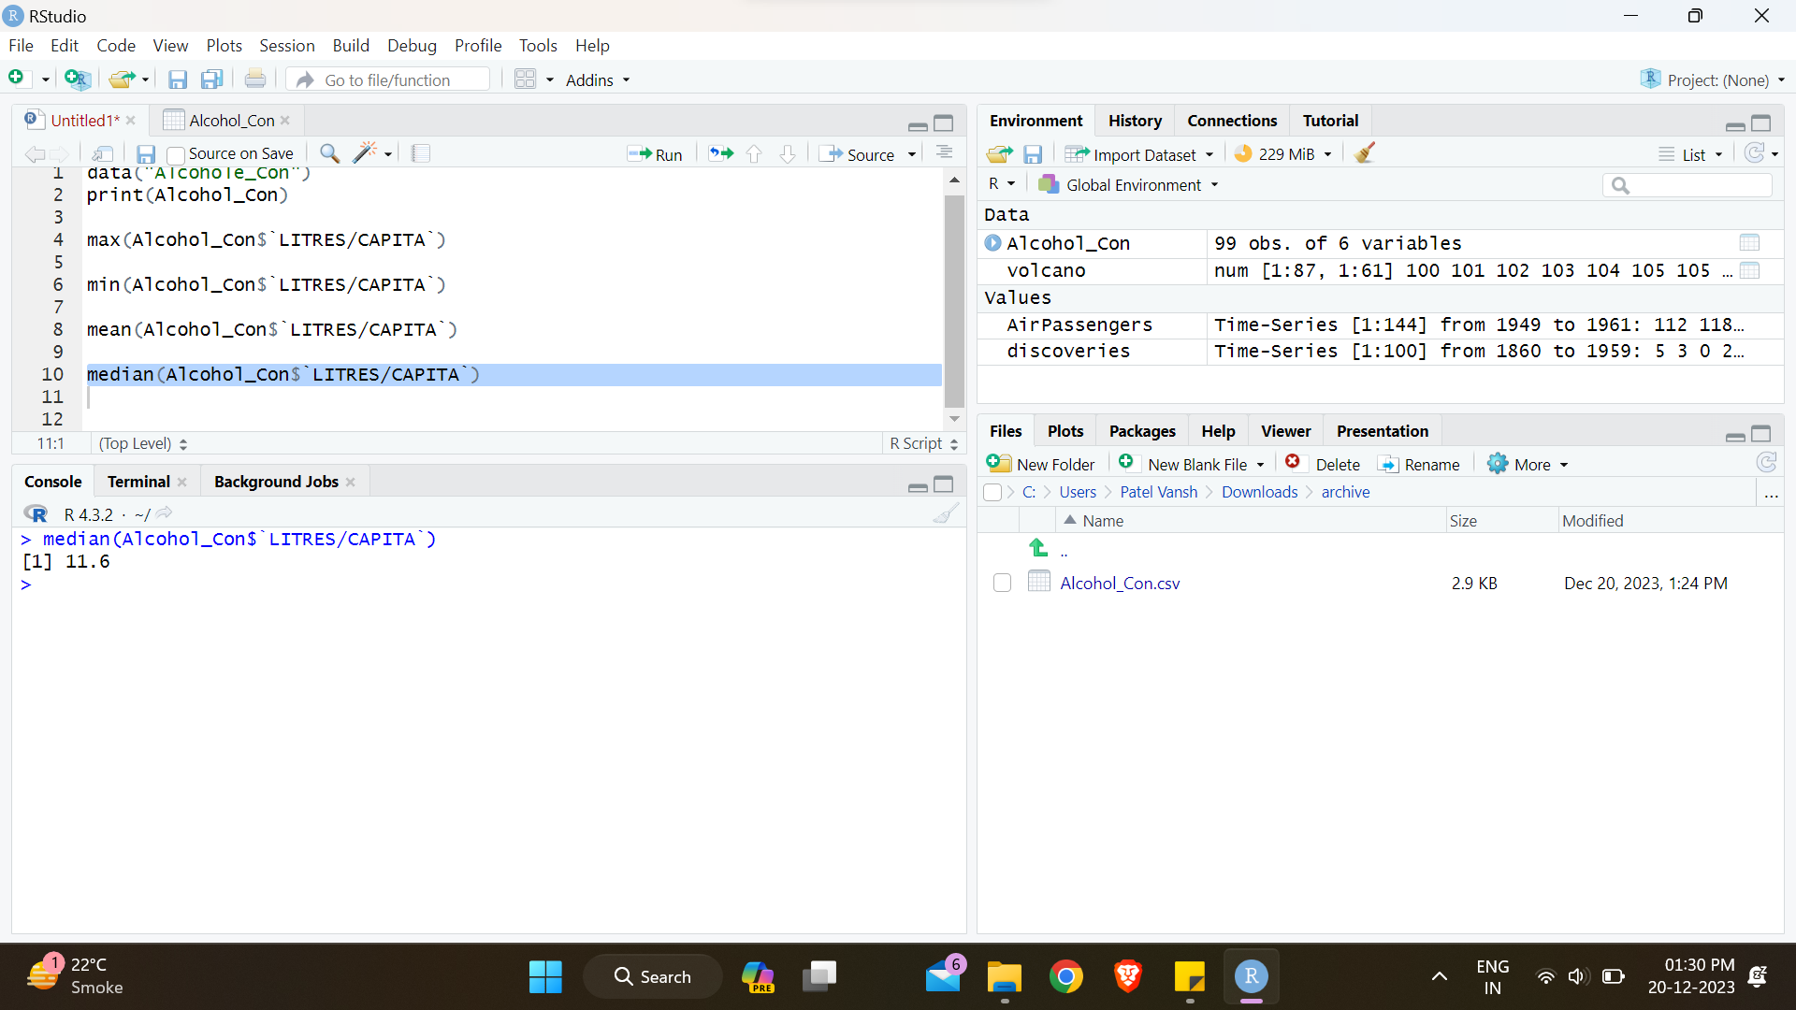
MEDIAN
After ordering the data the number which arrives in middle is median
Finding Median for litres/capita
Code:-median(Alcohol_Con$`LITRES/CAPITA`)

Slide 11
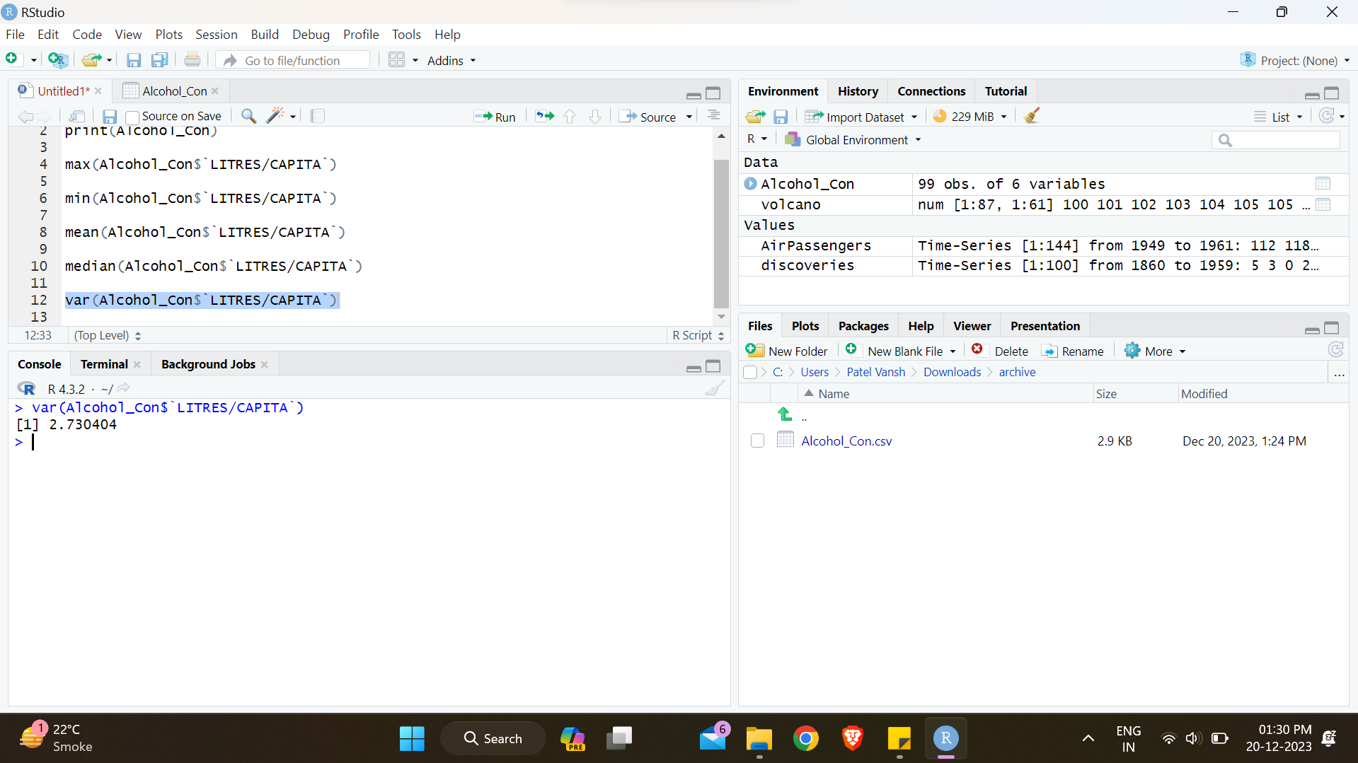
VARIANCE
Measurement of number which differ from mean
Finding variance for litres/capita
Code:-var(Alcohol_Con$`LITRES/CAPITA`)

Slide 12
DATA VISUALIZATIOn

Slide 13
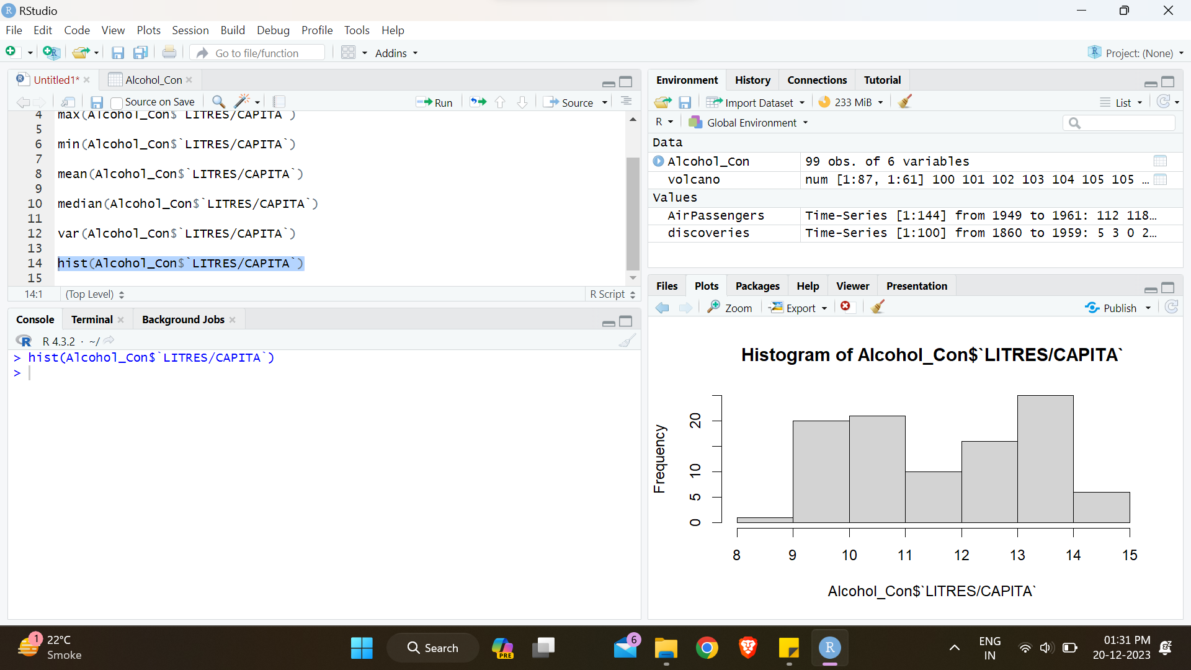
create a histogram
Code:-hist(Alcohol_Con$`LITRES/CAPITA`)

Slide 14
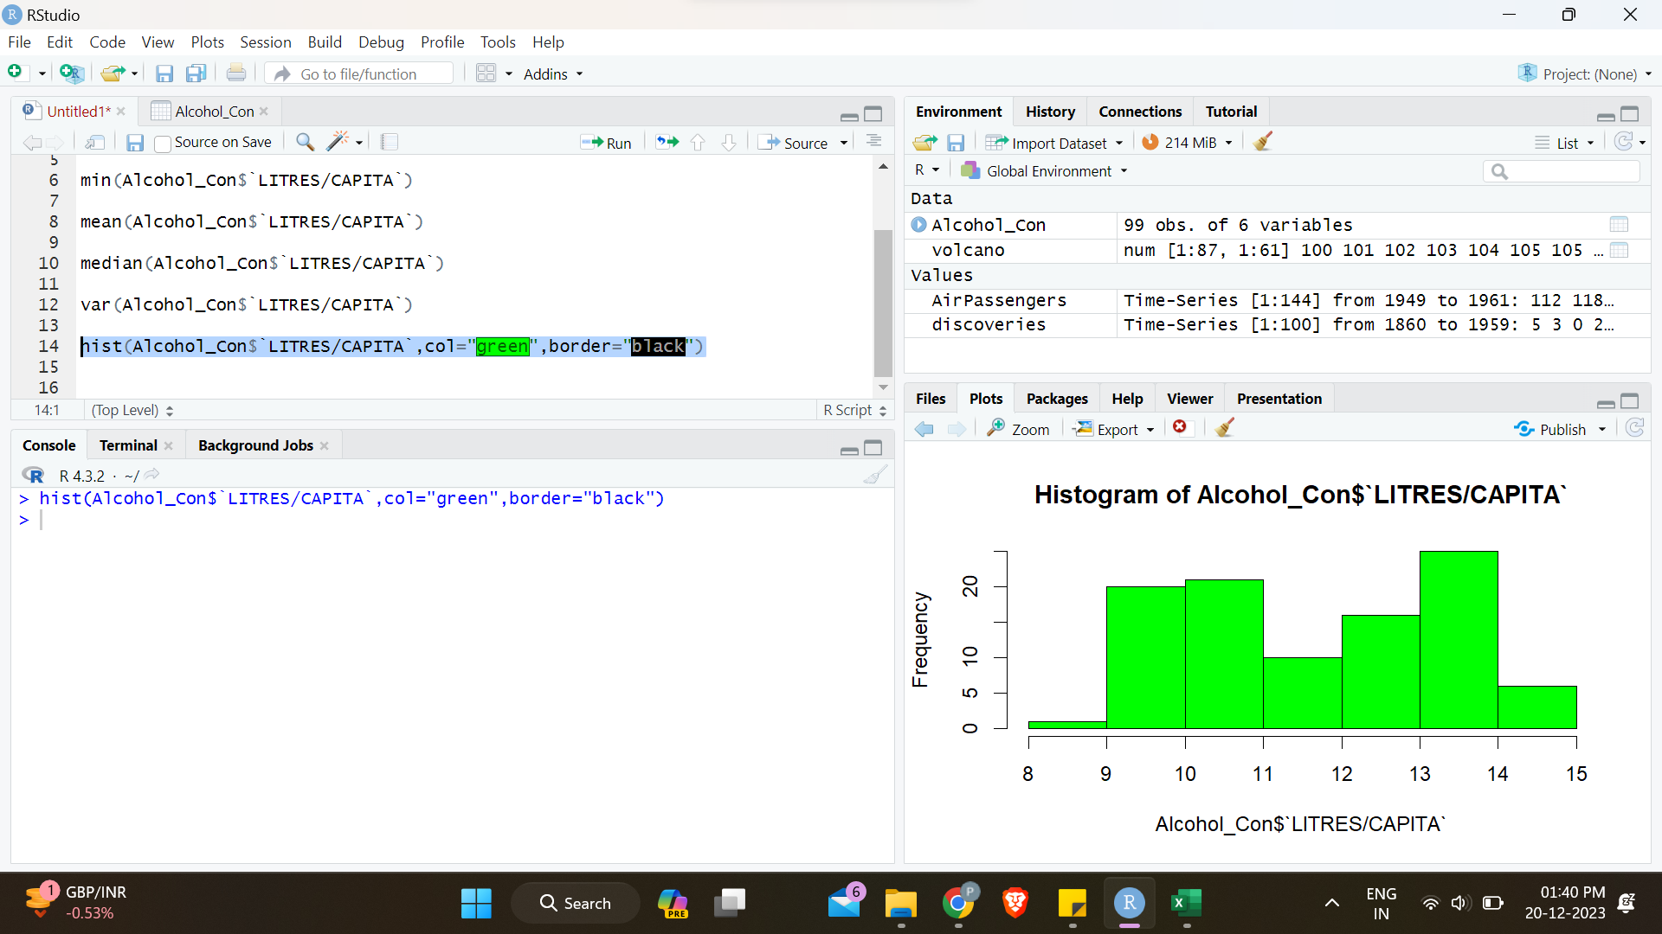
create a histogram AND ADD COLOUR
Code:-hist(Alcohol_Con$`LITRES/CAPITA`,col="green",border="black")

Slide 15
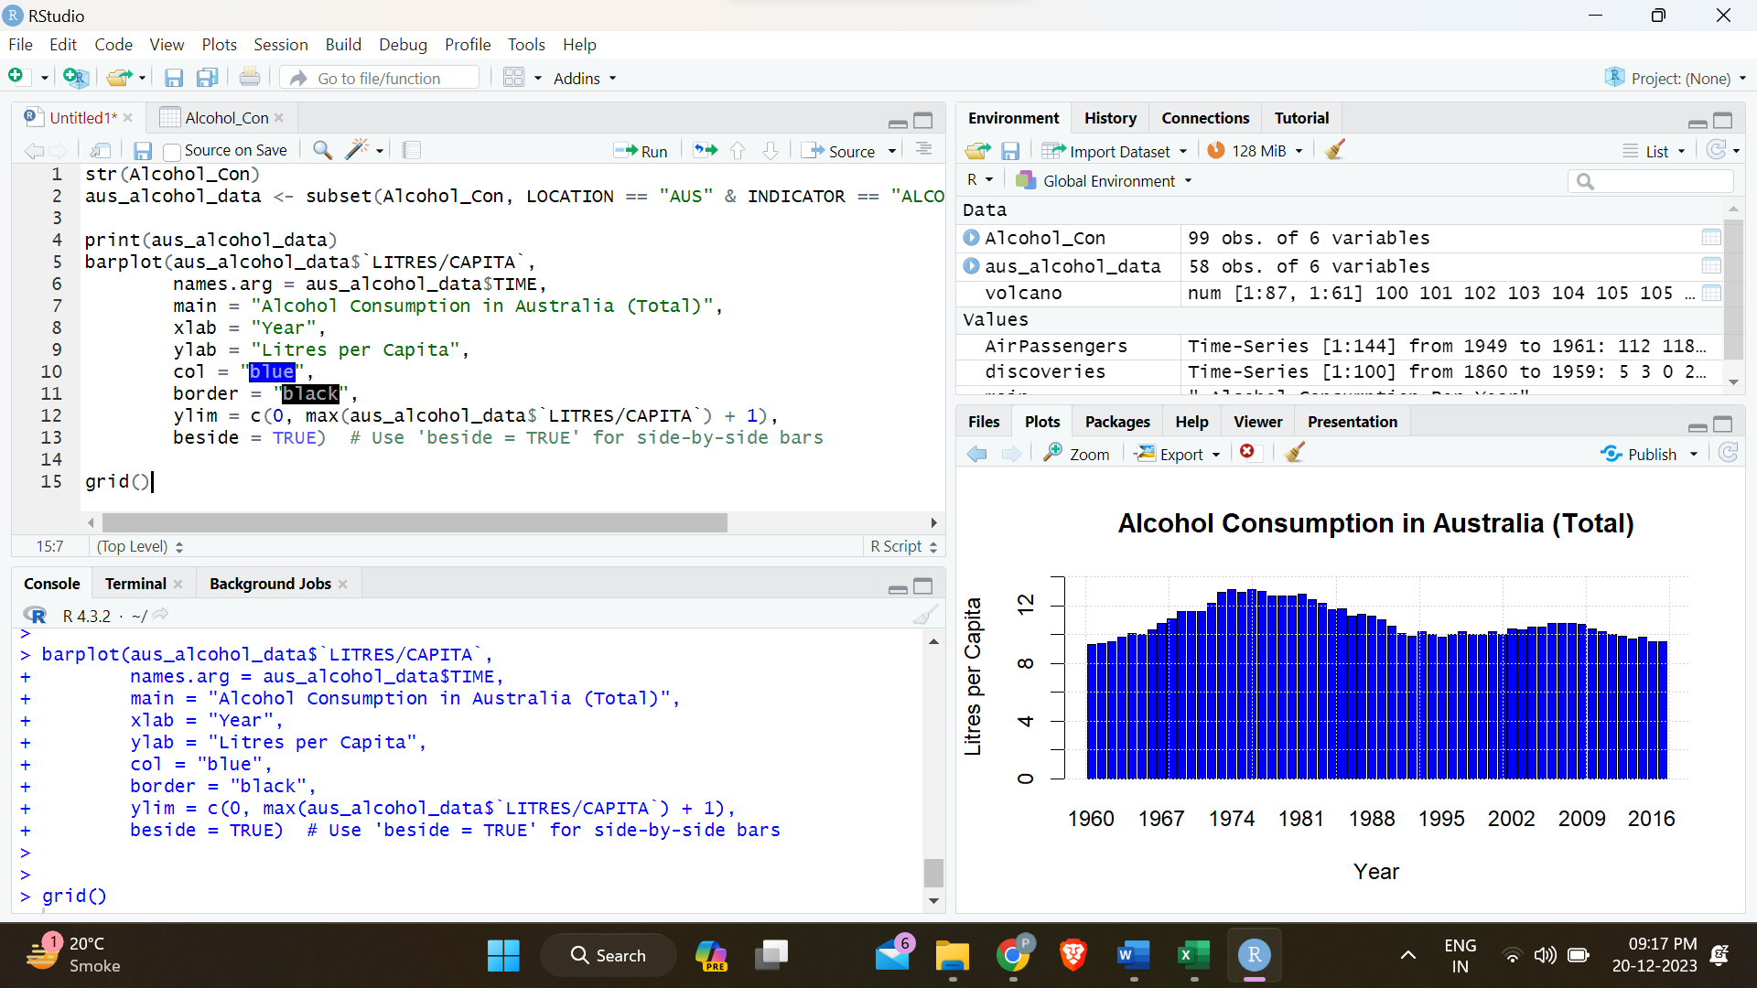
create a BARPLOT

Slide 16
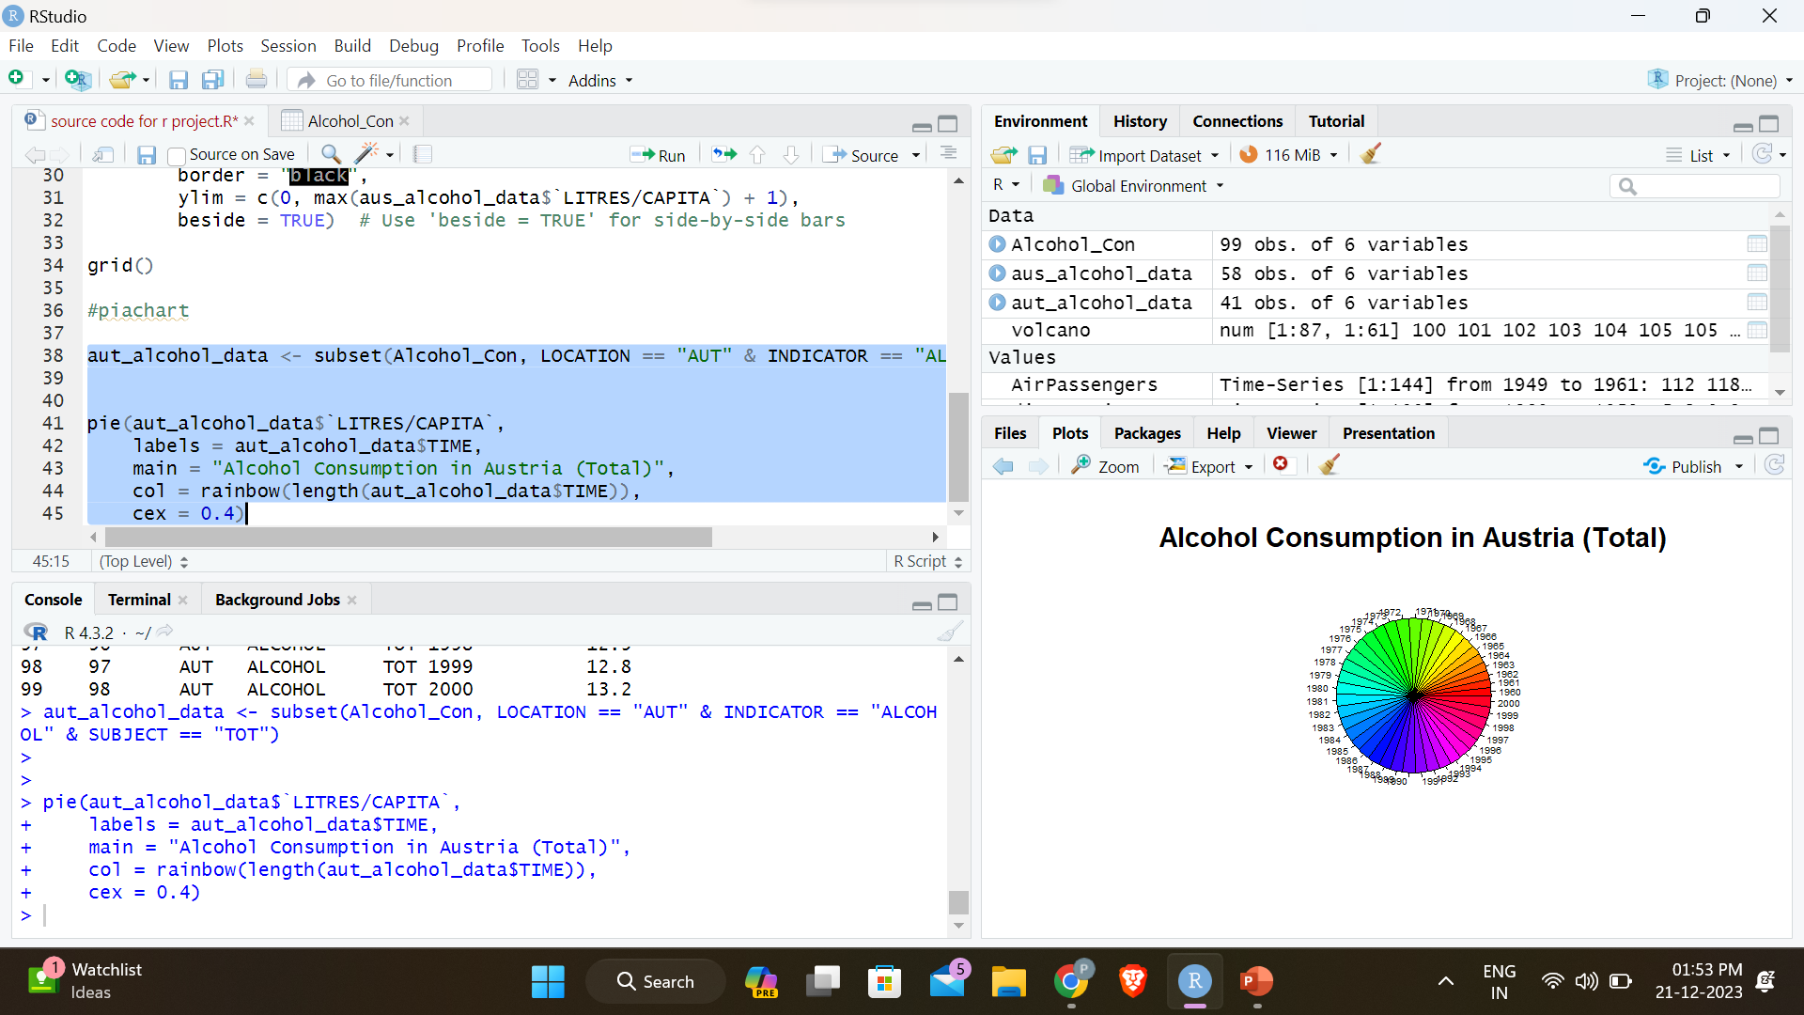
create a PIACHART

